Slide 1
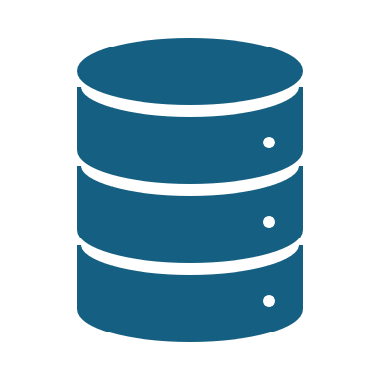
Database Interview QnA
#databaseInterview #codefarm

Slide 2




Explain the difference between SQL and NoSQL databases
#1
Database Interview QnA
#DatabaseInterview #codefarm

Slide 3
Differences
Data Model
Schema
Scalability
Transaction Support
Query Language
Use Cases
Examples

Slide 4
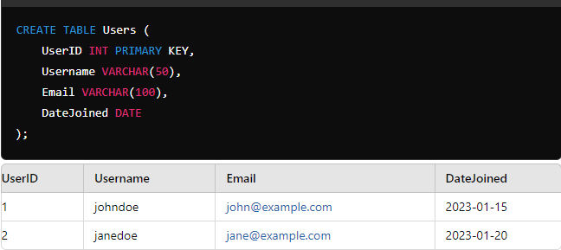
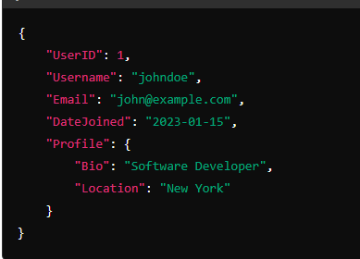
Data Model
SQL Databases
SQL (Structured Query Language) databases are relational.
They use a structured schema with tables, rows, and columns, where each table has a fixed schema defined by a set of fields.
The relationships between tables are established using foreign keys.
NoSQL Databases
NoSQL (Not Only SQL) databases are non-relational.
They can store unstructured, semi-structured, or structured data and often use flexible schemas.
Data can be stored in various formats, such as key-value pairs, documents, wide-columns, or graphs.

Slide 5
Schema
SQL Databases
They require a predefined schema before data can be inserted.
Any changes to the schema (e.g., adding a new column) can be complex and require careful planning.
NoSQL Databases
NoSQL databases typically have dynamic schemas, meaning fields can be added without affecting the existing data.
This allows for more flexibility and easier adaptation to changing data requirements.

Slide 6
Scalability
SQL Databases
SQL databases are generally vertically scalable, which means increasing the power of a single server (e.g., adding more RAM or CPU).
Horizontal scaling (adding more servers) can be challenging and complex.
NoSQL Databases
NoSQL databases are designed for horizontal scalability.
They can easily scale out by adding more servers to distribute the data and load, making them well-suited for handling large volumes of data and high-traffic applications.

Slide 7
Transaction Support
SQL Databases
SQL databases are known for their strong ACID (Atomicity, Consistency, Isolation, Durability) compliance, ensuring reliable transactions and data integrity.
NoSQL Databases
Many NoSQL databases sacrifice full ACID compliance for flexibility and performance.
They often follow the BASE model (Basically Available, Soft state, Eventually consistent), which is more suitable for distributed systems.

Slide 8
Query Language
SQL Databases
They use SQL as the standard query language, which is powerful for complex queries, joins, and aggregations.
NoSQL Databases
NoSQL databases often use query languages specific to their data model (e.g., MongoDB uses a JSON-like query language).
These are typically less standardized but can be more intuitive for specific data operations.

Slide 9
Use Cases
SQL Databases
Best suited for structured data and applications requiring complex queries, transactions, and data integrity.
Example - financial systems, traditional business applications.
NoSQL Databases
Ideal for unstructured or semi-structured data, large-scale applications, real-time analytics, and scenarios where flexibility, speed, and scalability are prioritized.
Example - social networks, IoT, big data applications.

Slide 10
Examples
SQL Databases
MySQL, PostgreSQL, Oracle, Microsoft SQL Server.
NoSQL Databases
MongoDB (document), Cassandra (wide-column), Redis (key-value), Neo4j (graph).

Slide 11
Summary
Feature | SQL Databases | NoSQL Databases
Data Model | Relational (Tables) | Non-relational (Document, Key-Value, Graph, etc.)
Schema | Fixed Schema | Dynamic Schema
Scalability | Vertical Scaling | Horizontal Scaling
Transaction Support | ACID Compliance | BASE Model (Eventual Consistency)
Query Language | SQL | Varied (e.g., JSON-based for MongoDB)
Data Integrity | High (Strong Consistency) | Varied (Eventual Consistency)
Use Cases | Structured Data, Complex Queries | Big Data, Real-time Analytics, Unstructured Data

Slide 12
What is an ORM and how does JPA/Hibernate work in a Spring application?
#2
Database Interview QnA
#DatabaseInterview #codefarm

Slide 13
ORM
Object-Relational Mapping
It is a programming technique that facilitates the conversion of data between incompatible systems (object-oriented programming languages and relational databases).
It allows developers to work with database records as if they were objects in the programming language, abstracting the underlying SQL queries.
Benefits
Simplified data manipulation
Automated CRUD operations
Maintainability
Database independence

Slide 14
JPA - Java Persistence API
It provides guidelines for mapping Java objects to relational database tables.
Core Concepts
Entities
Java classes that represent tables in a database.
EntityManager
The interface used for interacting with the persistence context (which manages entity instances).
Persistence Context
A cache of entity instances, which ensures that within a transaction, each entity is unique.
Persistence Unit
A configuration that defines entity classes and connection details.

Slide 15
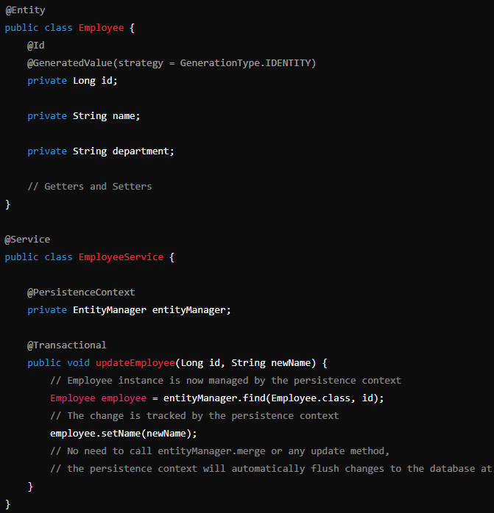
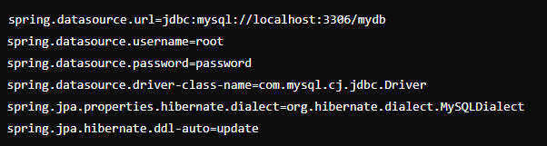
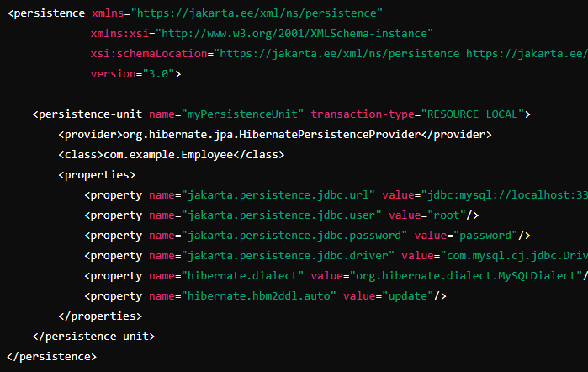
JPA - Java Persistence API

Slide 16
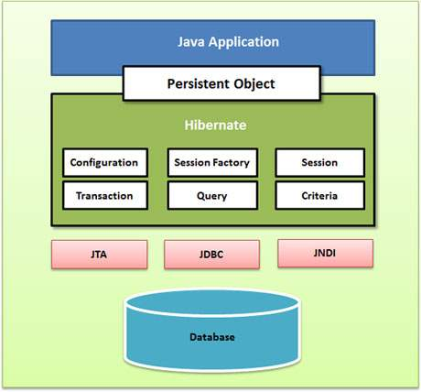
Hibernate
It is a popular ORM framework that implements the JPA specification.
It provides additional features beyond the standard JPA
Lazy/Eager Loading
Caching
Criteria API
Custom Types
Architecture
Session
Transaction
Query

Slide 17
JPA/Hibernate in a Spring Application
Integration
Spring Data JPA
Configuration
Entity Classes
Repositories
Transactions
Workflow in a Spring Application
Entity Creation
Repository Interface
Dependency Injection
Database Operations
Transaction Management

Slide 18
Follw-up Questions
Why use JPA over JDBC?
What are the differences between Lazy and Eager loading?
How does Hibernate handle caching?
What are the different types of mappings in JPA?
What is the N+1 Select problem?
How do you handle transactions in a Spring application using JPA/Hibernate?
What is the role of the EntityManager in JPA?
How do you optimize performance in Hibernate?
How does Hibernate manage the lifecycle of an entity?
What is JPQL, and how is it different from SQL?
How do you perform batch processing in Hibernate?

